Slide 1
Opening a Bar in Atlanta

Slide 2
Background
Atlanta is recognized as a hub of commercial activity
Atlanta is a leader in the Southeast for its financial service sector and is currently growing as a data center
The presence of these types of firms means that there are many young and middle aged professionals with disposable incomes and stressful jobs, who are looking for a place to drink

Slide 3
Interest
Opening a Bar or Restaurant in a metropolitan area such as Atlanta is challenging
Bars and restaurants usually operate on thin margins, so any competitive advantage in location would be beneficial to a potential owner.

Slide 4
Data Acquisition and Cleaning
Atlanta Regional Commission Neighborhood data, including Neighborhood Name, Geographical Coordinates, Population, and Census Data from here
Foursquare data on location names, location types, and geographical coordinates of the location from here
Features that did not correspond with our goals, such as the presence of ATMs were dropped from the Foursquare data table
The list of geographical coordinates from the Atlanta Regional Commission data was simplified down to a pair of coordinates

Slide 5
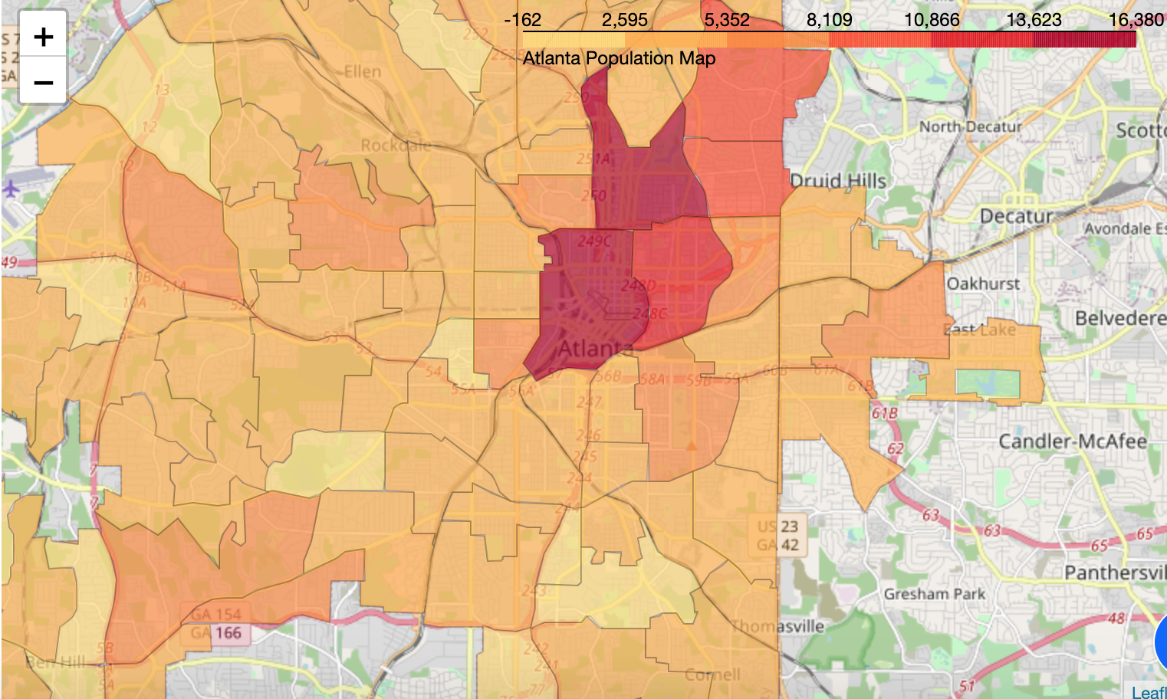
Choropleth Map

Slide 6
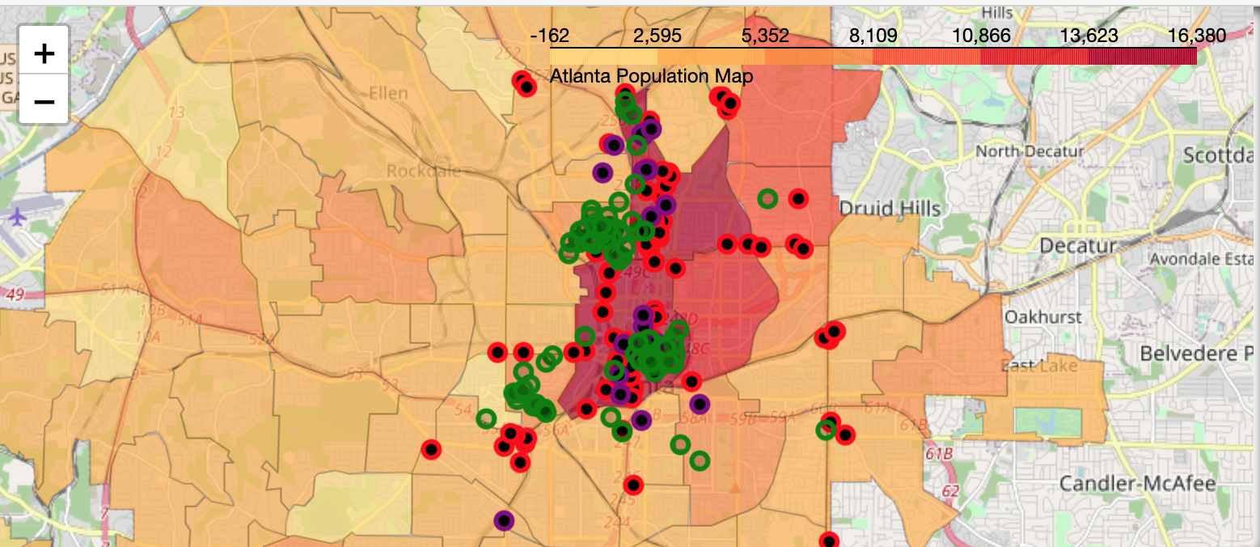
Folium Circle Marker Map
Colleges - GREEN
Law Offices - PURPLE
Banks - RED

Slide 7
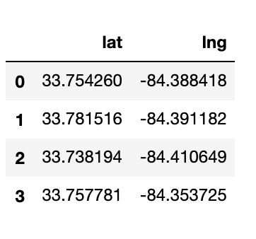
K-Means Clustering Results

Slide 8
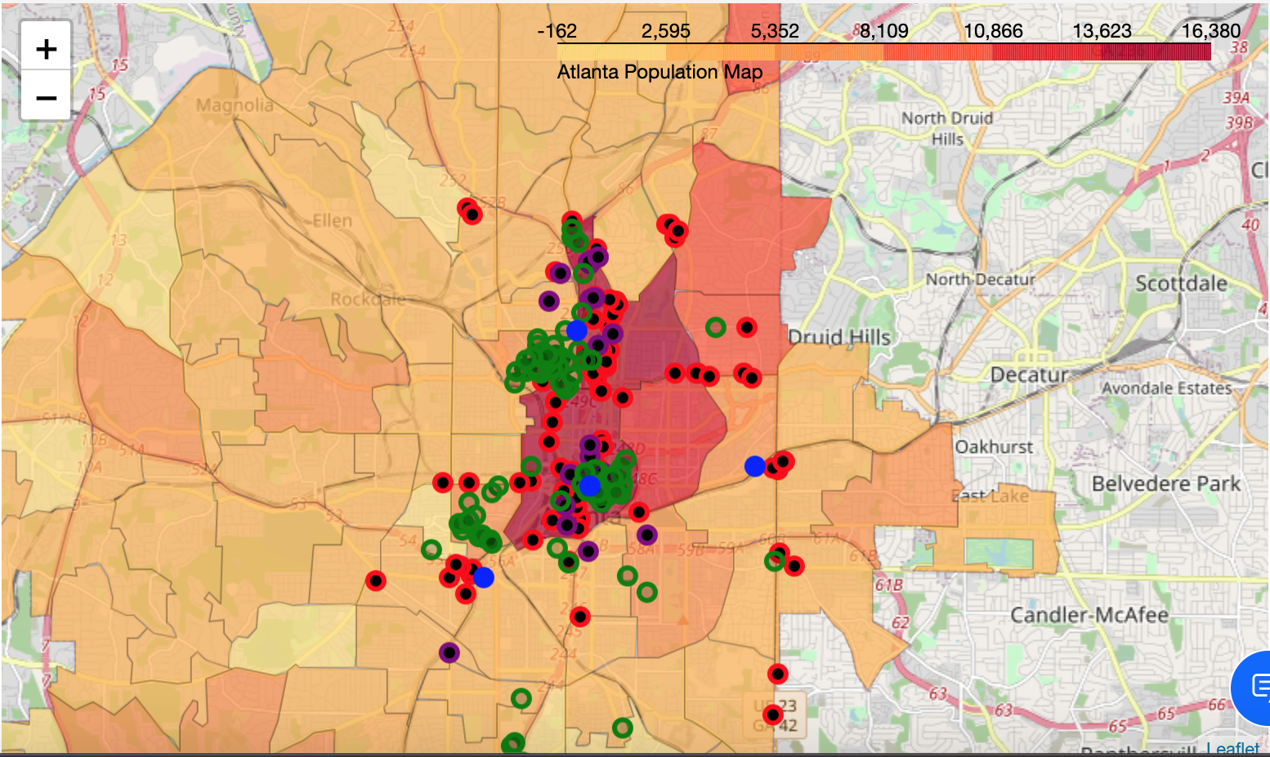
K-Means Clusters Plotted
Colleges - GREEN
Law Offices - PURPLE
Banks – RED
Potential Location - BLUE

Slide 9
Conclusion and Future Direction
Built a model to show the best place to open a bar aimed at young and middle-aged professionals with disposable incomes
Some future improvement to the model:
Consider the age of other bars in the area, as older bars are more likely to have a loyal customer base that won’t be interested in coming to a new bar
Consider the location of other bars in the area, as too many bars in a limited radius can cannibalize each other, and a new bar won’t be able to bring in enough customers to stay in business.

